Slide 1

IOT MINI PROJECT PRESENTATION
HEALTH MONITORING SYSTEM
DIVNEET KAUR 102115055
SIMRANJEET SINGH 102115056
DILPAL SINGH SONI 102115061
ANUJ TANGRI 102115065
KAVIPURAPU TARUN 102115067

Slide 2
Introduction
Project Overview
Health Monitoring System: Focuses on real-time tracking of vital health parameters (heart rate, oxygen levels) using wearable sensors.
Pulse Sensor: Provides real-time data on heart rate and oxygen levels.
OLED Display: Displays health parameters locally, eliminating the need for external devices like smartphones or computers.
Real-Time Monitoring: Immediate feedback on health parameters directly on the display.
System Performance:
Efficient in terms of resource utilization, providing continuous monitoring without overloading the device.
Adaptability to various conditions for seamless operation.
User Accessibility: The system is designed to be portable, user-friendly, and easily accessible, especially for users in remote or underserved areas.
AI Integration: Future enhancements could include the use of machine learning algorithms for predictive analytics, identifying potential abnormalities in the user’s health.
Goal: To offer a cost-effective, continuous health monitoring solution that helps individuals manage their health better and reduces the burden on healthcare systems.

Slide 3
Need Analysis and Scope
The need analysis identifies the necessity and relevance of the health monitoring system within the context of existing healthcare challenges. It highlights the gap in traditional healthcare systems and justifies the adoption of new technologies like IoT and AI
Hardware: The system will consist of a pulse sensor to monitor heart rate and oxygen levels, an OLED display to show real-time health data, and Bluetooth/Wi-Fi modules for data communication.
Software: The software will process the data from the sensors locally and display it on the OLED screen. It will also support remote data transmission for further analysis. Future versions could incorporate machine learning for predictive analytics.
User Interaction: Users will view health parameters directly on the OLED display and receive alerts for abnormal readings. Future updates may include AI-driven insights.
Environmental Considerations: The system will be portable and battery-powered, designed to operate in various environments with reliable performance under different conditions.
Future Enhancements: The system may expand to include machine learning for predictive health insights, integration with cloud services for remote medical analysis, and monitoring additional health parameters such as blood pressure and ECG.
Limitations: Initially, the system will focus on heart rate and oxygen levels, with potential connectivity challenges in remote areas, though offline data storage is a possible solution.
Objectives
Data Acquisition-Hardware System Design: Using IoT sensors, e.g., MAX30100 for pulse oximetry measurement, measure vital parameters such as pulse, heart rate, and SpO2 in real time.All the sensor data must be brought to the processing unit via a valid communication protocol, such as serial communication with Arduino.
Data Storage-Store data in a format that can be analyzed and be compatible with the machine learning pipeline.
Interconnection with the System-Integrating IoT hardware with a machine learning model to enable real-time predictions. Develop data pipeline for preprocessing data from sensors and feeding into a model, retrieved as real time predictions
Mobility and Cost effectiveness-Cost-effective components to make it affordable and accessible to a wide range of users.
Machine Learning-Based Prediction-Data Preparation: Propose a machine learning model that can

Slide 4
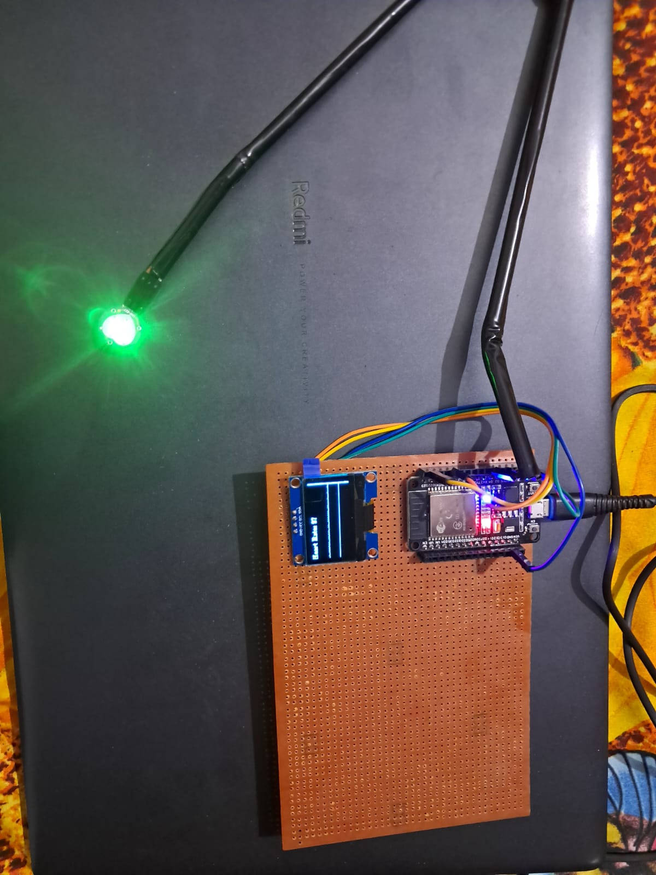
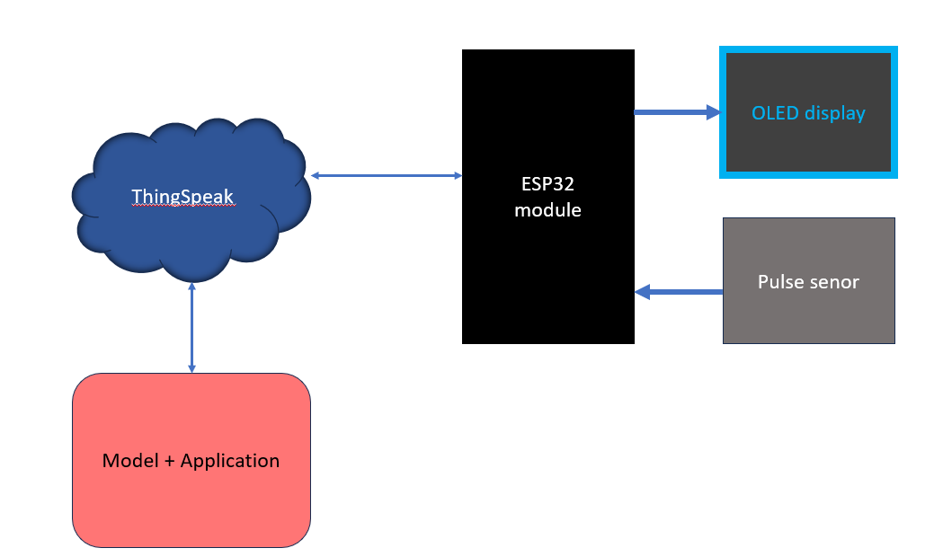
Proposed Approach
Concept Diagram :
( Clear detailed schematic / block diagram / flow chart depicting the proposed concept / solution )

Slide 5
Prospective Learning of the
Wired Communication Technologies: Focus on real-time data transmission using protocols like UART for efficient serial communication and I2C for connecting multiple sensors with minimal pins.
Ethical and Security Considerations: Emphasis on ensuring data integrity, privacy, and ethical handling of sensitive health data.
Machine Learning and Real-Time Integration: Training machine learning models, such as Random Forest, for health condition predictions and integrating them for accurate real-time insights.
System Reliability and Scalability: Addressing noise and signal degradation while building a modular, scalable system for future sensor and feature integration.

Slide 6
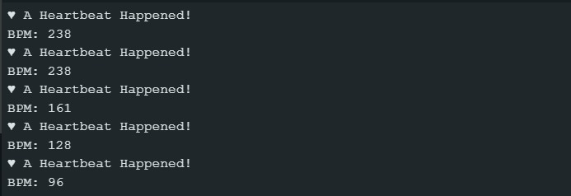
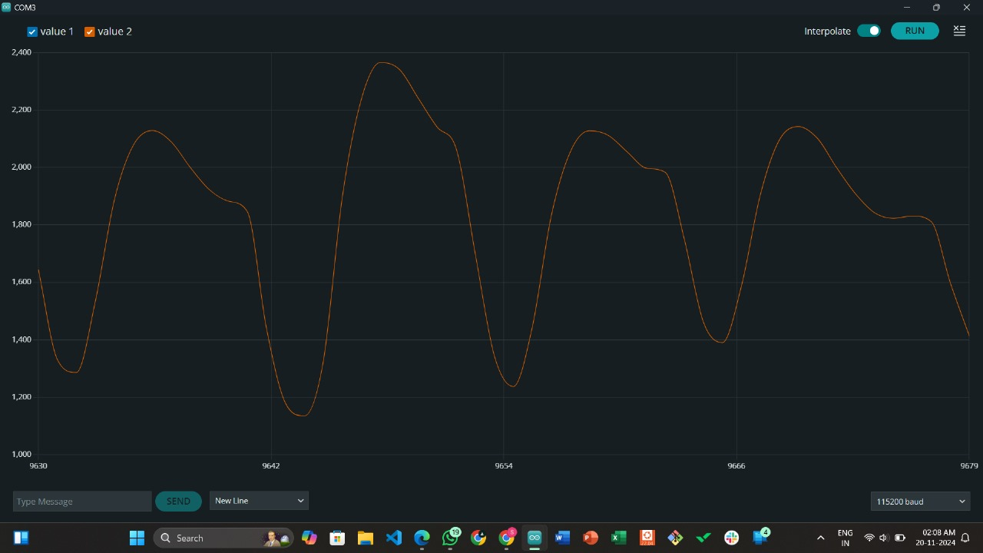
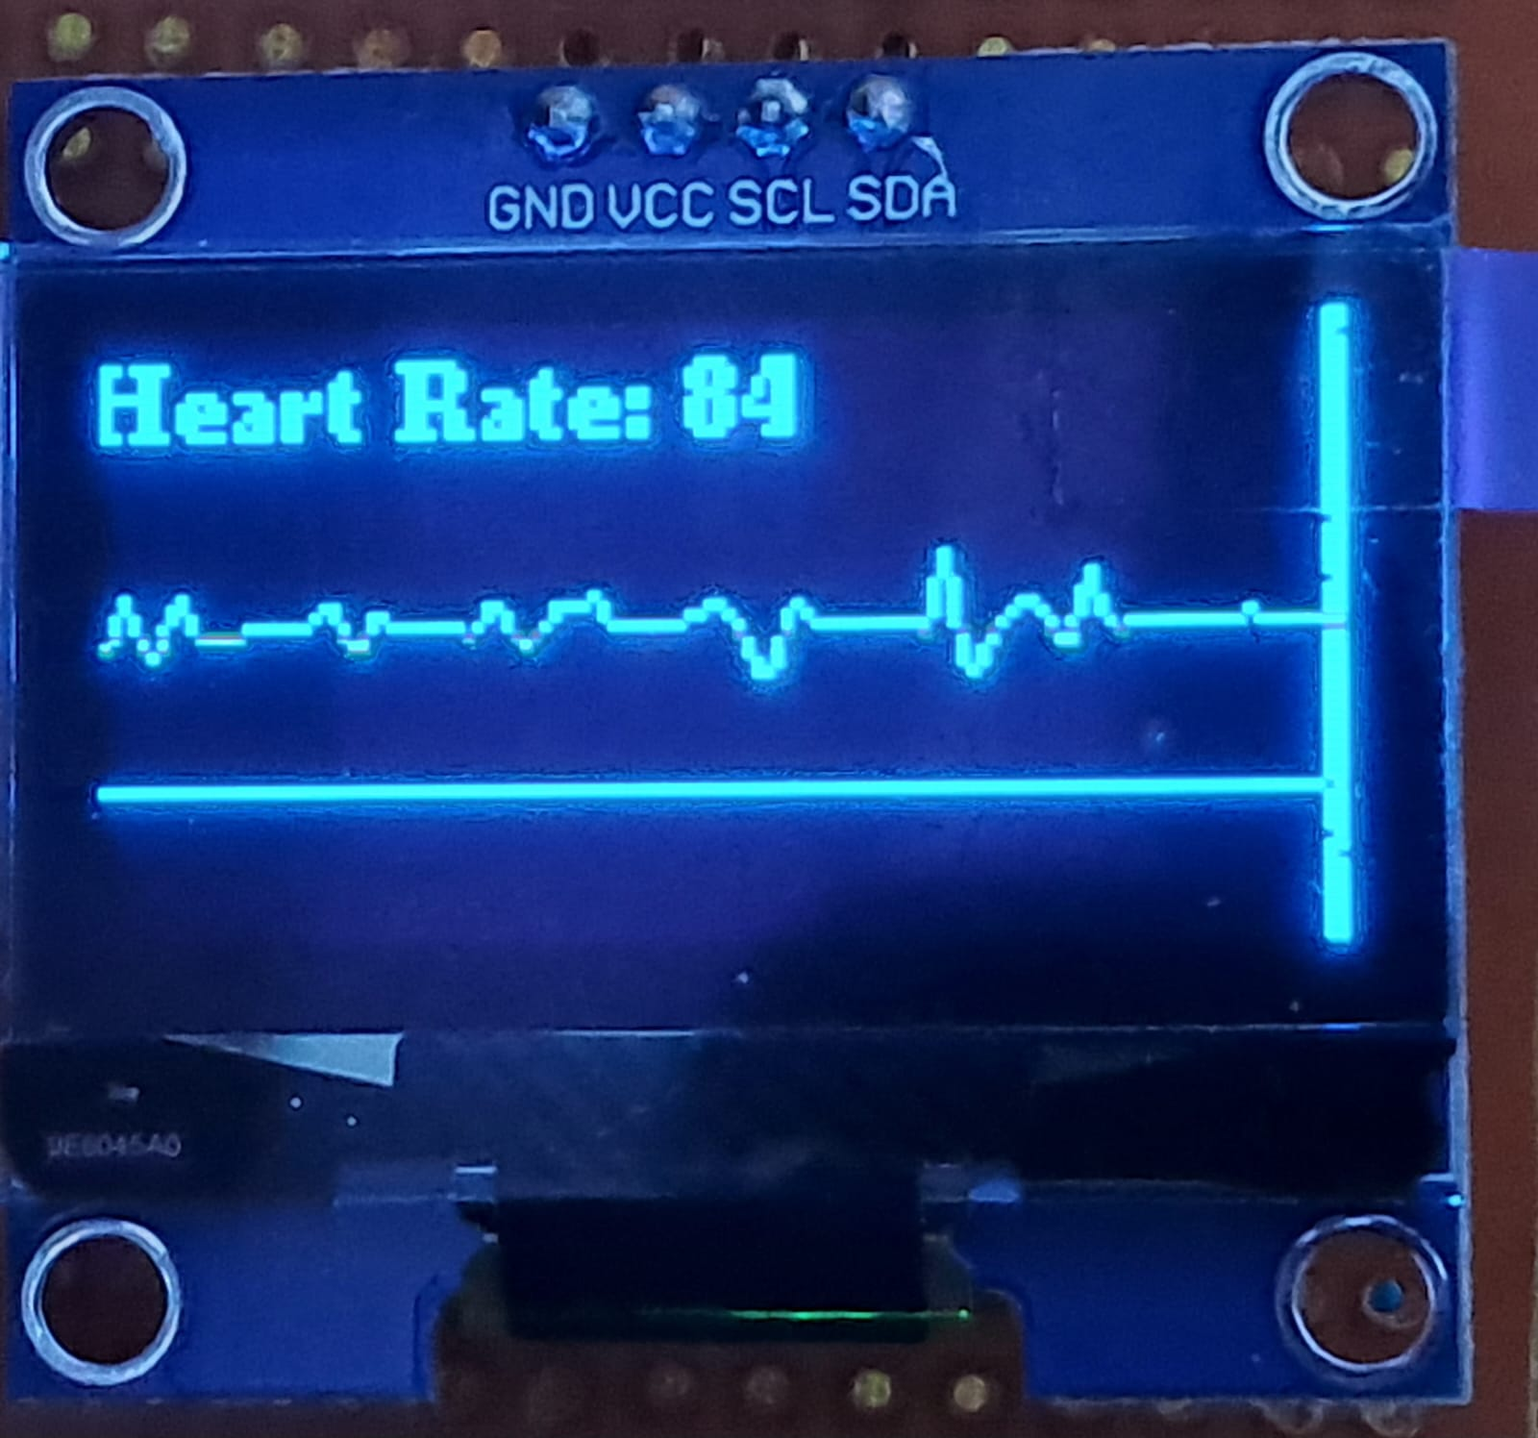
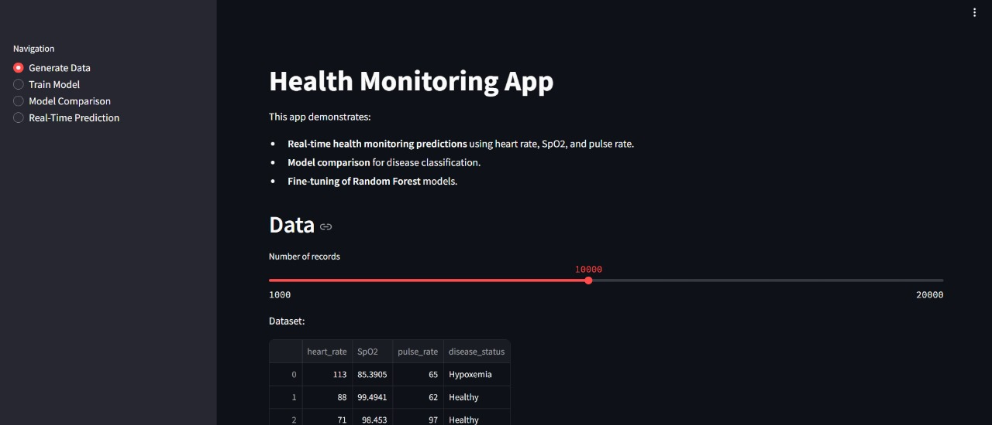
Outcomes of the Project

Slide 7
Thank you

